Slide 1
Assignment 2
ACIT 4880
Machine Learning
Tamim Hemat and Daryush Balsara

Slide 2
Agenda
Dataset
EDA
K Means Clustering and Initial Clusters
Random Forest Clustering
Logistic Regression

Slide 3

Dataset - Red Wine Quality
Our dataset consists of 12 columns with 1600 records
There was no missing data
One of the columns was unusable so we worked with 11 of the columns
We had 10 independent variables (features) and 1 dependent (discrete target value)
Features:
Target Value: Wine quality
fixed acidity
volatile acidity
citric acid
residual sugar
chlorides
free sulfur dioxide
density
pH
sulphates
alcohol
Notes:
daryush

Slide 4
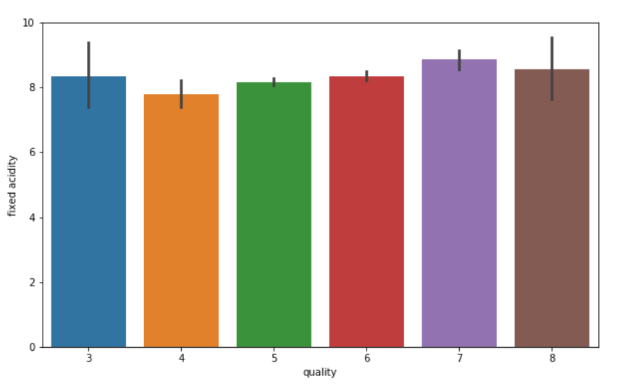
EDA
Notes:
Daryush
From this graph we can see that there is no trend for the fixed acidity that relates to the quality of wine. It is pretty much constant for all classes if different quality. This would probably mean that this feature won’t be disruptive for our learning models.

Slide 5
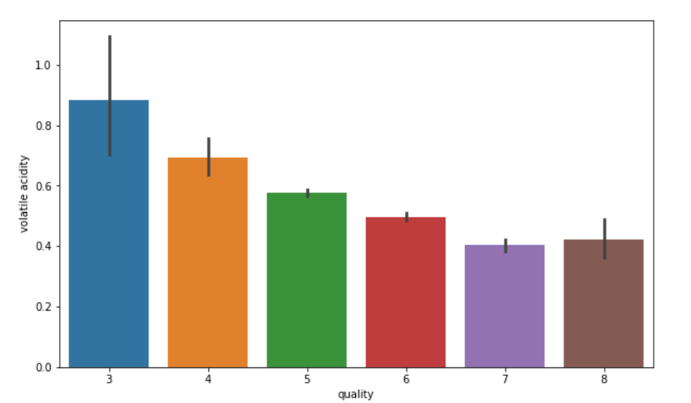
EDA

Slide 6
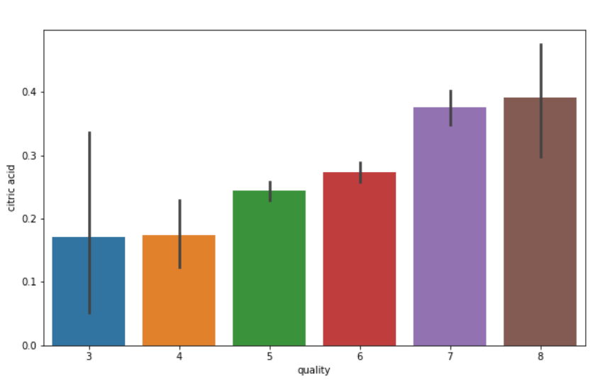
EDA

Slide 7
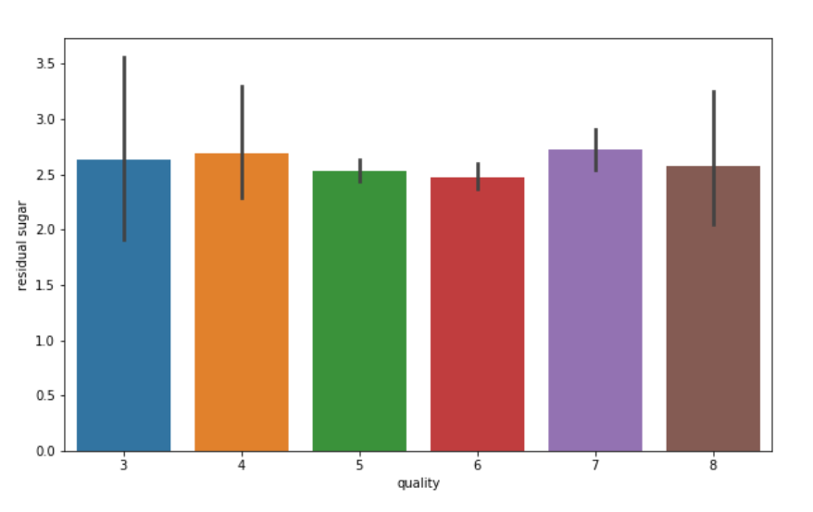
EDA

Slide 8
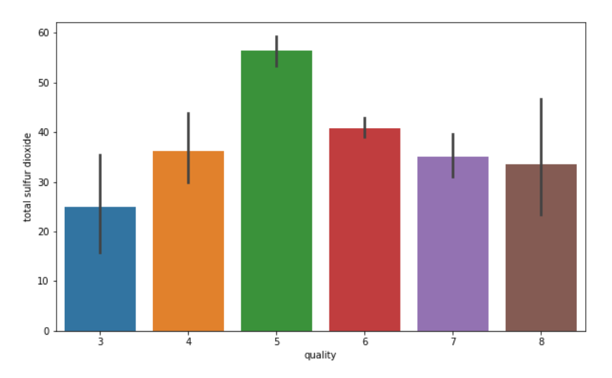
EDA
Notes:
daryush
And this is our last graph. From it we can see that the amount of total sulfur dioxide varies significantly between the different quality classes without following a pattern. We can assume that it wouldn’t be an ideal feature for our training models.

Slide 9
K-Means Clustering
We used the elbow method to find the optimal numbers of clusters
Found the optimal number being 6
Used the acidity and alcohol features of the data to categorize types of wine
Initially clusters were tightly coupled
The centroids were very close to each other

Slide 10
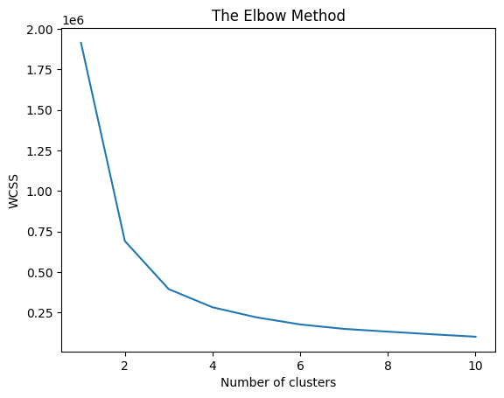
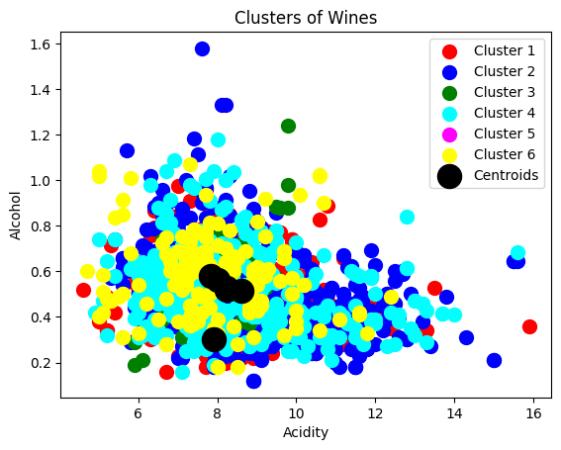
Initial clusters

Slide 11
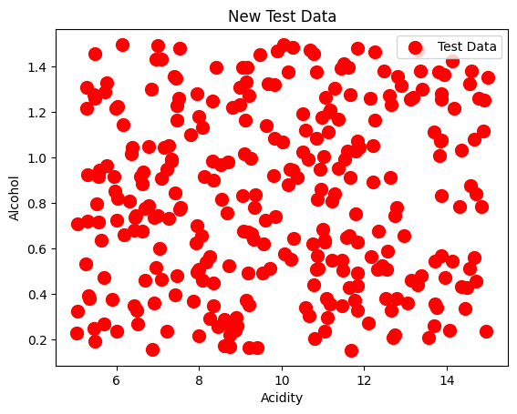
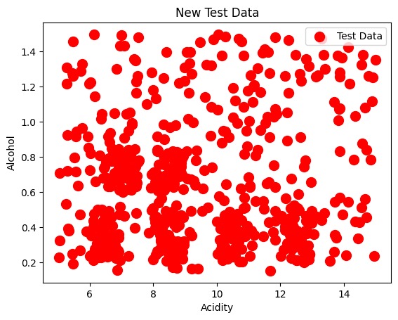
Adding extra data for training the model

Slide 12
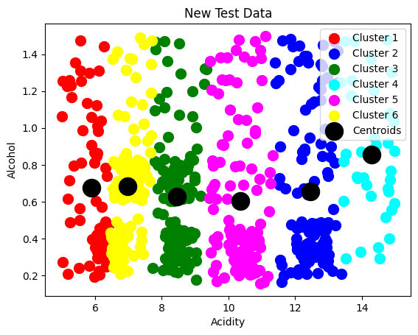
Final Clusters - they are distinct

Slide 13
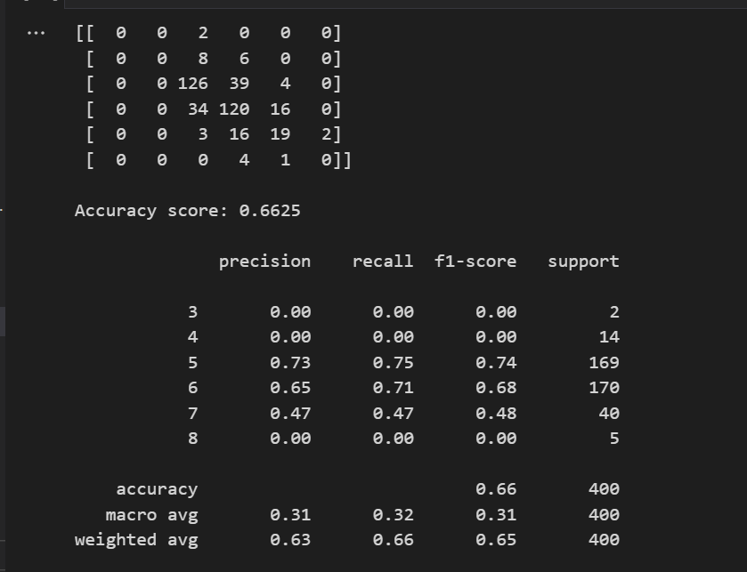
Random Forest Classification
Initially we used fixed acidity,volatile acidity,citric acid,total sulfur dioxide,pH,alcohol for features
Set the quality of the wine as the target value then we split the data for testing
We applied standard scaling for the features
We trained the model using entropy as the criterion and 100 estimators (trees)
We got the confusion matrix, accuracy score, and classification report
Notes:
Daryush The overall recall for the model is slightly better than overall precision. Precision is the ratio between correct predictions over all predictions for a specific class. Recall is the ratio between correct predictions over all values that were part of the actual class for the predictions.

Slide 14
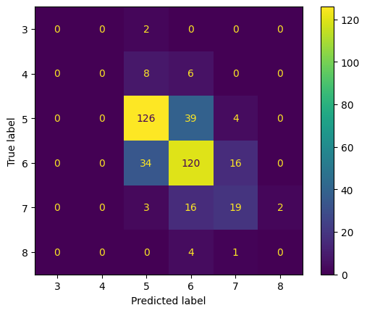
Notes:
Daryush
In the confusion matrix, the top left to bottom right diagonal contains the correctly predicted values. Our classification contains 6 different classes. We can see that our model gets a little “confused” (no pun intended) when deciding if an entry belongs to class 3 or class 4. It also has a little confusion when deciding between class 4 and 5 but not as much as with class 3 and 4.

Slide 15
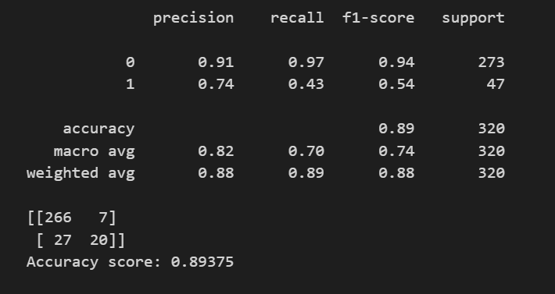
Random Forest Classification
Used a label and encoder to divide wine quality into good and bad
Then we used all features and we set the quality as the target value and then we split the data for testing again
Applied standard scaling
Trained the model using entropy as the criterion and 200 estimators (trees)
Got the confusion matrix, classification report, and accuracy score
Notes:
Daryush
When labeling the wine quality into “good” and “bad” our target value becomes binary (“bad” is 0 and “good” is 1), which allows for higher accuracy and precision. In this case our accuracy goes up to almost 90%. Also in this case the overall precision becomes higher than the overall recall.

Slide 16
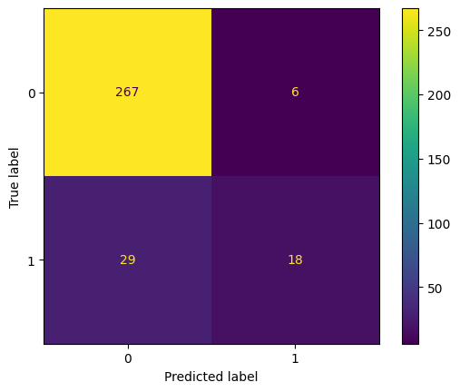
Notes:
Daryush
This is the confusion matrix when wine quality is set to good or bad We can see that it mostly predicts correctly when a wine is considered bad or good We have a low rate of False negatives and False Positives

Slide 17
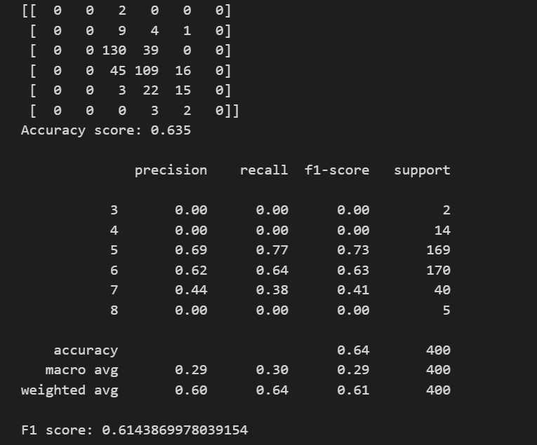
Logistic Regression
We started by used all features
We set the quality of the wine as the target value then we split the data for testing
We applied standard scaling for the features
We trained the model using the LBFGS algorithm, multinomial class and 1000 iterations
We got the confusion matrix, accuracy score, and classification report and F1 score
Notes:
Limited-Memory Broyden-Fletcher-Goldfarb-Shanno Algorithm

Slide 18
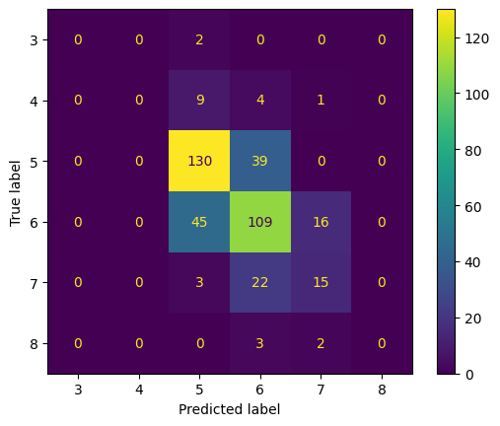

Slide 19
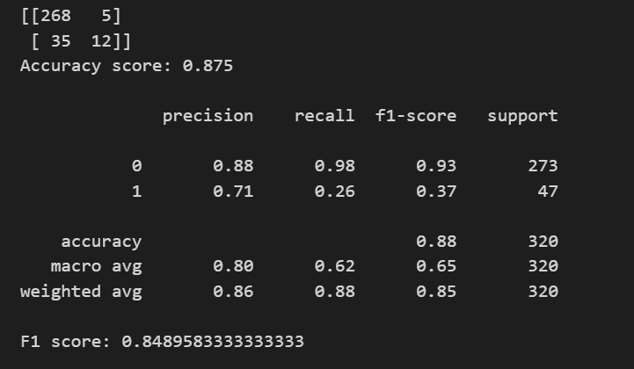
Logistic Regression
We used a label and encoder to divide wine quality into good and bad
Then we used all features and we set the quality as the target value and then we split the data for testing again
Applied standard scaling
Trained the model using the LBFGS algorithm, multinomial class and 1000 iterations again
Got the confusion matrix, classification report, accuracy score and F1 score

Slide 20
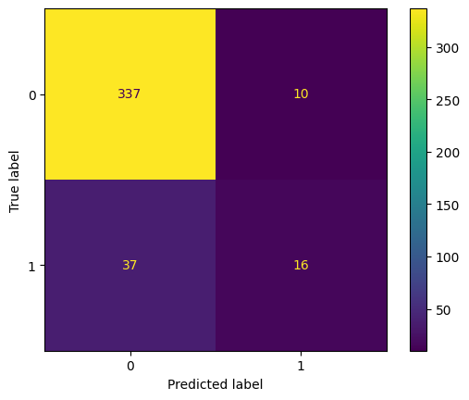

Slide 21
Insights and Conclusion
We found out that wine types differ by acidity level and not alcohol percentage
With our dataset, Random Forest Classification performs better than Logistic Regression because of the nature of the target value (i.e. discrete classes)
Even with less features to work with Random Forest Classification outperforms Logistic Regression for the target values (6 features vs 10 features)
We get more accurate results and higher precision when we labeled the target value into “good” and “bad” wine quality.
Even when using labeling, Random Forest Classification performs better than Logistic Regression
We could use the results from K-Means clustering for different types of wine to determine which type of wine has the highest percentage of “good” wines against “bad” wines
Notes:
daryush

Slide 22
Thanks for watching Questions

